Slide 1
Stanford ME469: Review of Pressure Projection; Boundary Conditions
Stefan P. Domino
Computational Thermal and Fluid Mechanics
Sandia National Laboratories SAND2018-4536 PE

Slide 2
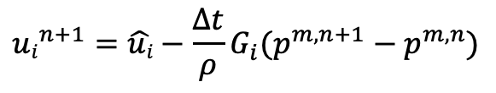


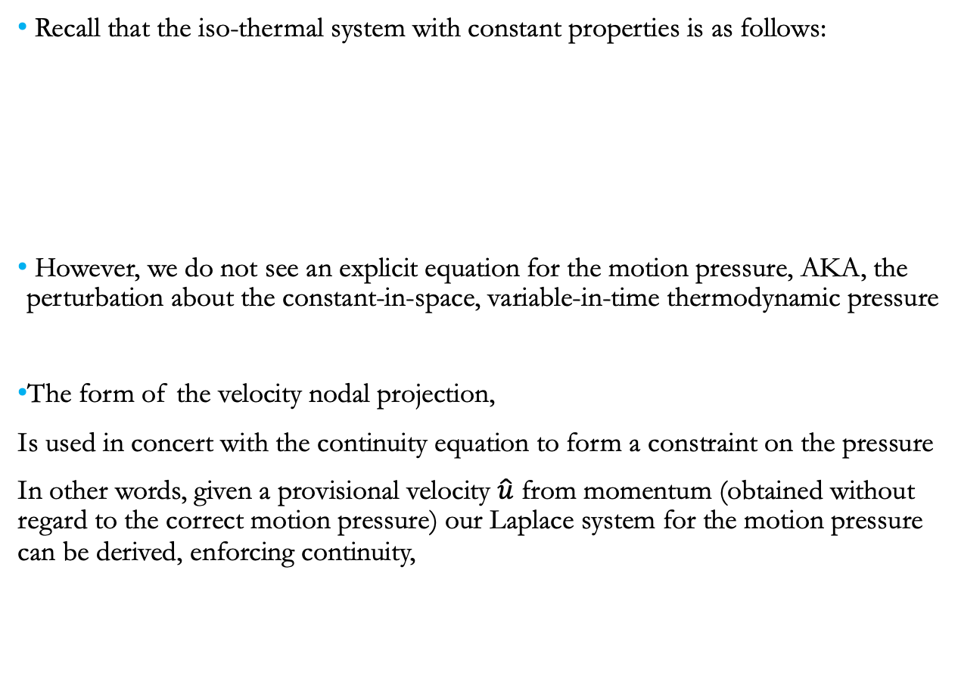
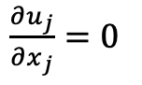
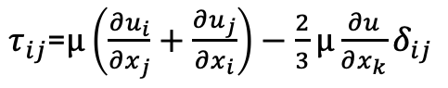
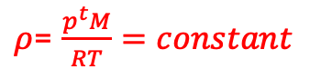
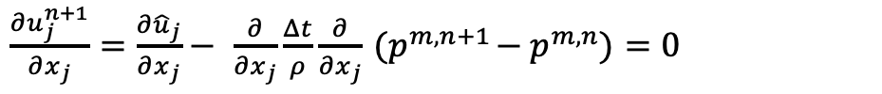
Review on low-Mach and Pressure Projection
Recall that the iso-thermal system with constant properties is as follows:
However, we do not see an explicit equation for the motion pressure, AKA, the perturbation about the constant-in-space, variable-in-time thermodynamic pressure
The form of the velocity nodal projection,
Is used in concert with the continuity equation to form a constraint on the pressure
In other words, given a provisional velocity $\hat{u}$ from momentum (obtained without regard to the correct motion pressure) our Laplace system for the motion pressure can be derived, enforcing continuity,
0.0
Equations:
$\frac{∂u_{j}}{∂x_{j}}$ $=0$
Constitutive:
$τ_{ij}$=$μ\left(\frac{∂u_{i}}{∂x_{j}}+\frac{∂u_{j}}{∂x_{i}}\right)−\frac{2}{3}μ\frac{∂u}{∂x_{k}}δ_{ij}$
$\frac{∂ρu_{i}}{∂t}+\frac{∂ρu_{j}u_{i}}{∂x_{j}}$ - $\frac{∂τ_{ij}}{∂x_{j}}=\frac{−∂p^{m}}{∂x_{i}}$
$$μ=constant$$
Unknowns: u_{i}, p^{m}
Properties:
$ρ$= $\frac{p^{t}M}{RT}=constant$
$${ui}^{n+1}=\hat{ui}−{\frac{Δt}{ρ}G_{i}(p}^{m,n+1}−p^{m,n})$$
$\frac{∂u_{j}^{n+1}}{∂x_{j}}$ $=\frac{∂{\hat{u}}_{j}}{∂x_{j}}−$ $\frac{∂}{∂x_{j}}\frac{Δt}{ρ}\frac{∂}{∂x_{j}}{ (p}^{m,n+1}−p^{m,n})=0$
This is the so-called Pressure Poisson Equation

Slide 3
Incremental Approximate Pressure-Projection with Pressure Stabilization Errors
Let the inverse of A, A⁻¹ be approximated by B₂ as a scalar, τ (which is ~ time scale)
Let B₁ be equal to the scaled Laplace operator, - τL
The new splitting and stabilization error is given by:
The above can be shown to hold a second-order temporal error (coming)
Here, due to equal-order interpolation, i.e., collocation of primitives, L != DG
Therefore, L-DG ~ 4th-order pressure stabilization (pressure oscillations damped)
However, pressure-stabilization error remains
Momentum and Continuity:
$$\left[\begin{matrix}A & 0 \\ D & −τL\end{matrix}\right]\left[\begin{matrix}\hat{u} \\ p^{n+1}\end{matrix}\right]=\left[\begin{matrix}\hat{f} \\ −DτGp^{n}\end{matrix}\right]$$
$$A\hat{u}=f−Gp^{n}$$
$$D\hat{u}=τ(Lp^{n+1}−DGp^{n})$$
Nodal Projection:
$$\left[\begin{matrix}I & τG \\ 0 & I\end{matrix}\right]\left[\begin{matrix}u^{n+1} \\ p^{n+1}\end{matrix}\right]=\left[\begin{matrix}\hat{u} \\ \hat{p}\end{matrix}\right]+\left[\begin{matrix}τGp^{n} \\ 0\end{matrix}\right]$$
$$u^{n+1}=\hat{u}−{τG(p}^{n+1}−p^{n})$$
$$p^{n+1}=\hat{p}$$
Examples:
Rhie-Chow (1983)
Peric (1985)
Domino (2006)
$$\left[\begin{matrix}A & G \\ D & 0\end{matrix}\right]\left[\begin{matrix}u^{n+1} \\ p^{n+1}\end{matrix}\right]=\left[\begin{matrix}f \\ 0\end{matrix}\right]+\left[\begin{matrix}\left(I−Aτ\right)G{(p}^{n+1}−p^{n}) \\ τ\left(L−DG\right)p^{n+1}\end{matrix}\right]$$

Slide 4
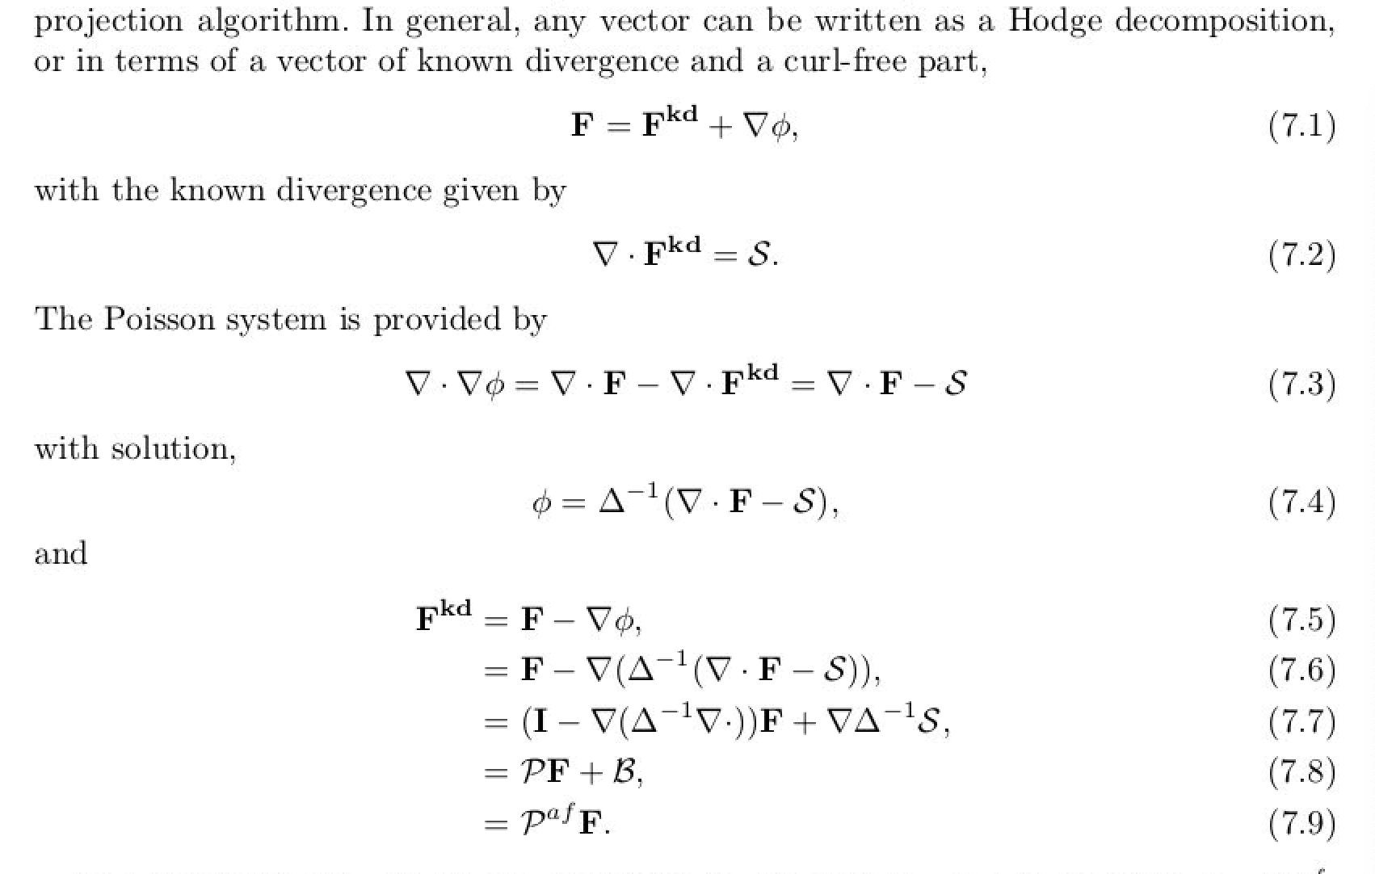
Why ”pressure projection”?
From Domino, 2006 “﻿Toward verification of formal time accuracy for a family of approximate projection methods using the method of manufactured solutions”
For a solenoidal vector, div(u) is zero and P is an “idempotent” projection, i.e., P=P²
Otherwise, P is an affine-projection operator

Slide 5
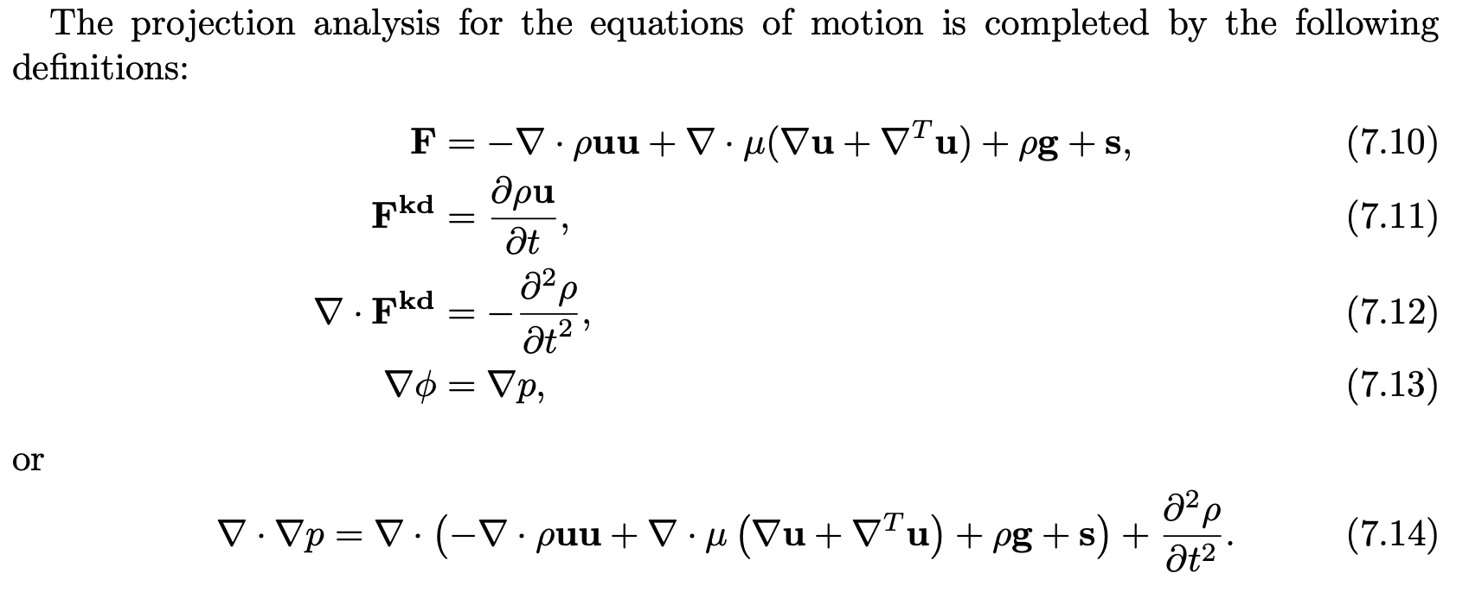
Formal Projection Applied to low-Mach system
From Domino, 2006 “﻿Toward verification of formal time accuracy for a family of approximate projection methods using the method of manufactured solutions”

Slide 6
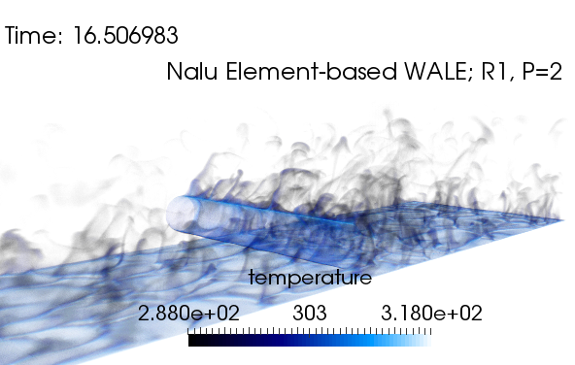
A note on boundary conditions
Typical boundaries include the following (mapping to what we know physically in the system):
Inflow: quantities are known
Wall: velocity, temperature, scalar flux, etc., are known (“no-slip”)
Open: flow leaves or enters the domain with a known “pressure” (static or total); zero gradient
Symmetry: no-penetration, zero tangential viscous condition
Periodic: perfect mapping between nodes at provided surface pairs; provides an infinite domain assumption
Non-conformal: static or dynamic/sliding mesh interface in which the surface pair is non-conformal in nature
Symmetry, “flow slips along” (normal stress pn_{i}dS applied with tangential stress = 0)
Open
(known P and far field temperature)
Inflow
(known T and u_{i})
Span-wise periodic
Neumann for p everywhere other than open; SPL
Wall (known T and u_{i})

Slide 7
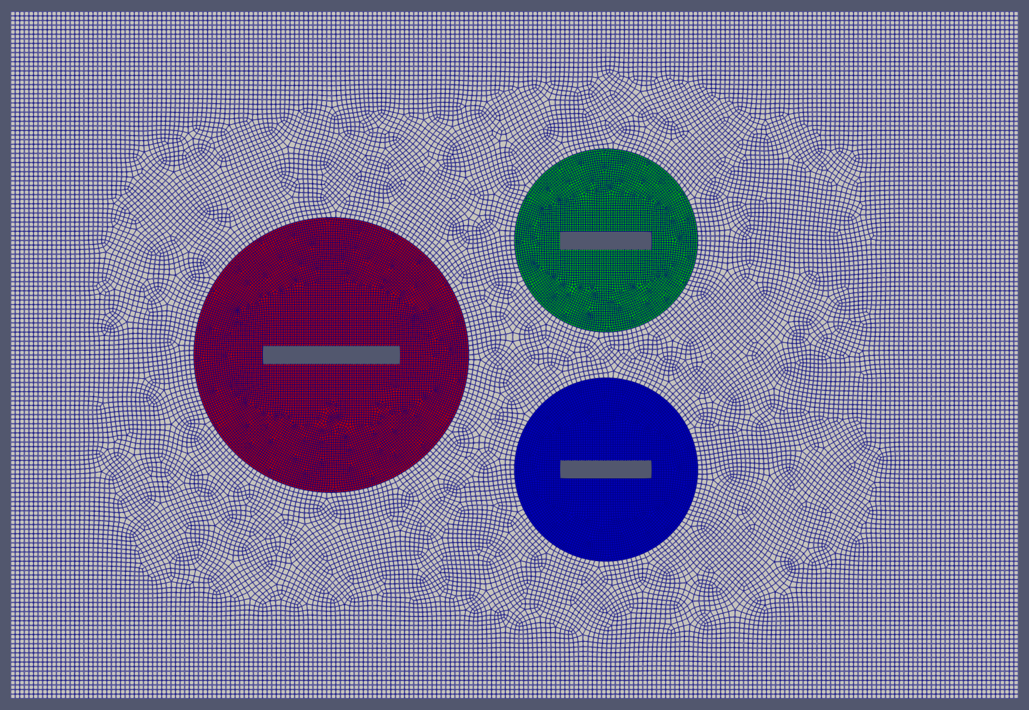
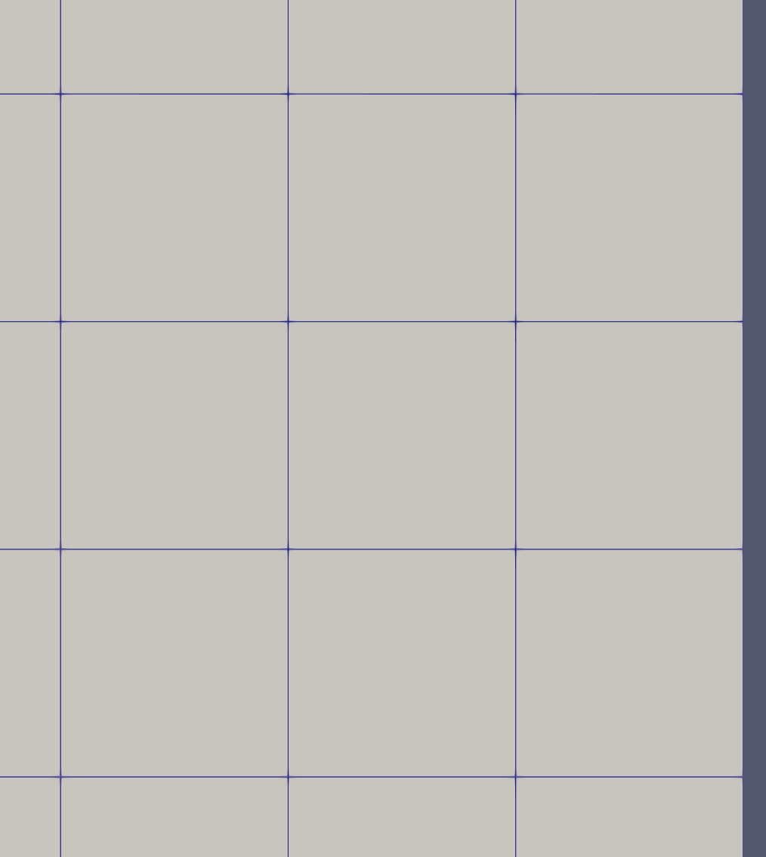
Boundary Condition Locations
Recall, that for a 1) vertex-based discretization scheme, the degree of freedom at boundary faces reside on the boundary allowing for “weak” or “strong”, while 2) cell-centered approaches support “weak”, or “flux-based”

Slide 8
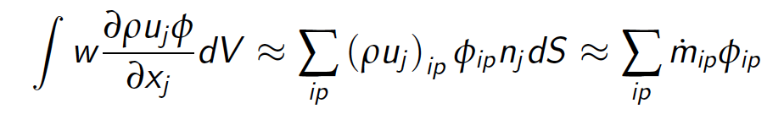
Boundary Condition Locations: Weak, i.e., “Flux” vs “Strong”, i.e., Dirichlet
Recall, that for a 1) vertex-based discretization scheme, the degree of freedom at boundary faces resides on the boundary allowing for “weak” or “strong”, while 2) cell-centered approaches support “weak”, or “flux-based”
Consider an inflow of φ (entering the domain from the right to the left)
Vertex-based can choose weak
or strong. It’s your choice

Slide 9
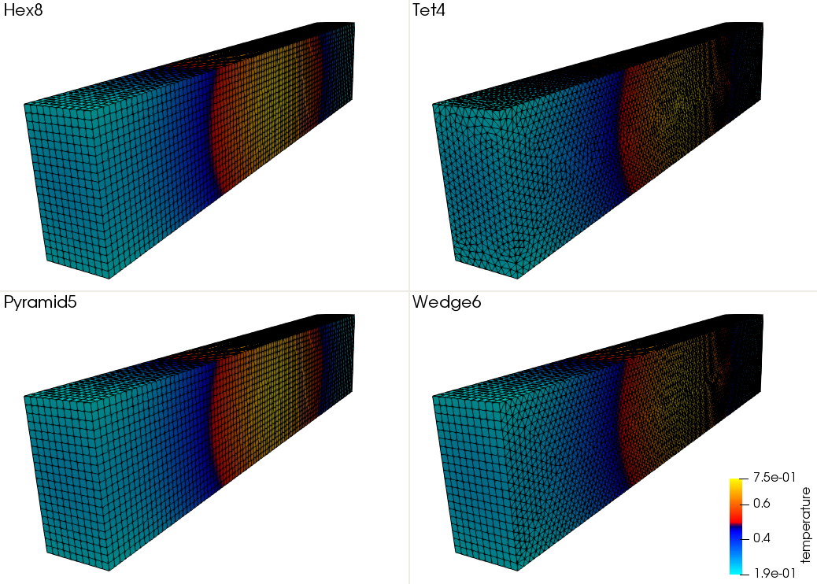
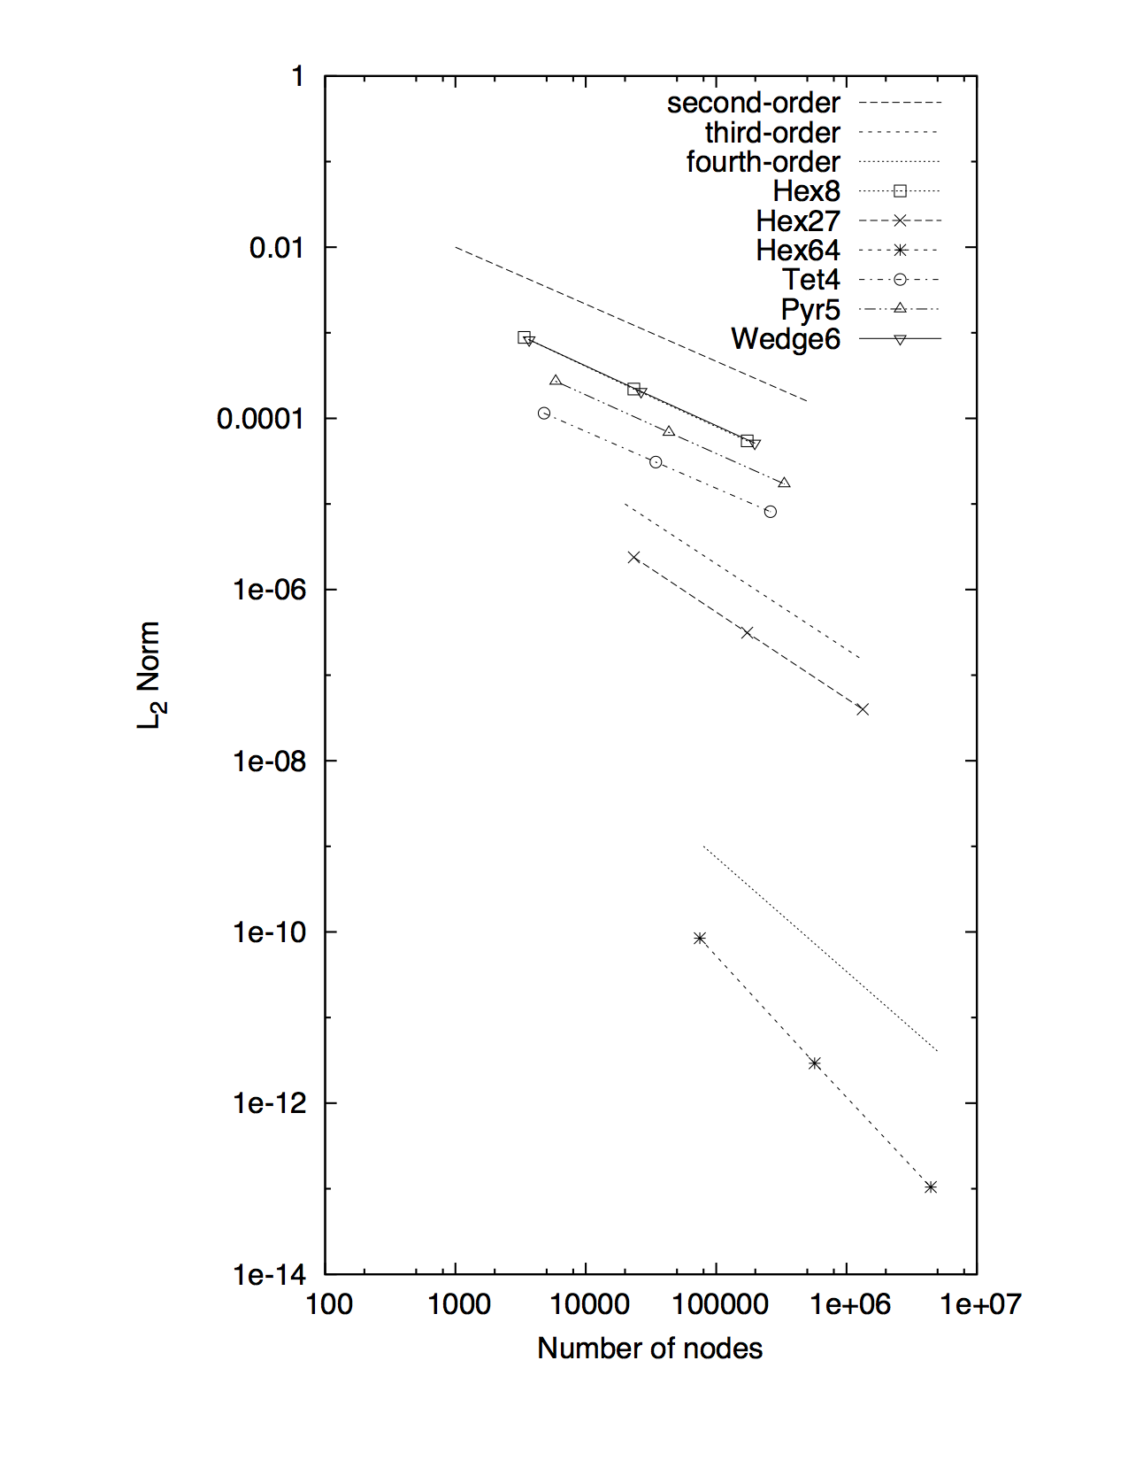

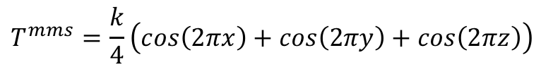
Weak vs Strong Example
$$T^{mms}=\frac{k}{4}\left(cos\left(2πx\right)+cos\left(2πy\right)+cos\left(2πz\right)\right)$$
For vertex-based schemes, the degree-of-freedom “lives” at the boundary
In some cases, e.g., wall, inflow and open, boundary condition can be provided by a Dirichlet bc (AKA, strong implementation of a known field).
A Dirichlet procedure either condenses the row out of the system or zeroes the row with a unity in the diagonal and the specified value on the RHS
Consider a simple heat conduction solution in which temperature is known at the boundaries
It can be shown (see Svard and Nordstrom, JCP, 2008) that a stable and accurate weak BC implementation is provided by:
$$q_{n}=−λ\frac{∂T}{∂x_{j}}n_{j}+γ\frac{λ}{L}\left(T−T^{bc}\right)$$
Here, γ is a constant greater than unity

Slide 10
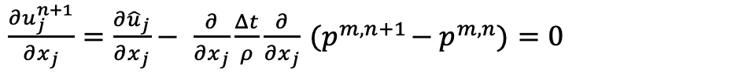
Revisiting the Pressure Poisson Equation Boundary Conditions (1/2)
Recall, a typical PPE (absent of any pressure stabilization details) is as follows:
This equation can be viewed as a constraint on the current velocity field to ensure that the continuity equation is enforced
“What pressure correction do I need to compute such that when I project the current velocity to the space of known divergence, the continuity constraint is met”
Recall, this equation was the ramification of the low-Mach derivation in which the EOS that links pressure and density was removed
However, what are the boundary conditions for pressure?
Typically, Neumann, i.e., zero flux at walls and inflows, while open boundary provides a specified pressure
For all inflow or walls, all Neumann BCs leads to a singular system, with the predicted pressure given to an additive constant that may actually vary in time!
$\frac{∂u_{j}^{n+1}}{∂x_{j}}$ $=\frac{∂{\hat{u}}_{j}}{∂x_{j}}−$ $\frac{∂}{∂x_{j}}\frac{Δt}{ρ}\frac{∂}{∂x_{j}}{ (p}^{m,n+1}−p^{m,n})=0$

Slide 11


Revisiting the Pressure Poisson Equation Boundary Conditions (2/2)
Proper Pressure BC (inflow/walls), Gresho and Sani, 1987 with consistent Neumann BC:
Zero Neumann provides a so-called “spurious boundary layer” and is proportional to the viscous term for typical cases of non-blowing and non-changing moving walls, time scale ~ ν/y²
$$Q_{j} =−\left(\frac{∂ρu_{i}}{∂t}+\frac{∂ρu_{j}u_{i}}{∂x_{j}}\right)+\frac{∂{2μS}_{ij}}{∂x_{j}}+ρg_{i}$$
$\frac{∂P}{∂n}$ $=n_{j}Q_{j}$
with
P.M. Gresho, R.L. Sani, ”On pressure boundary conditions for the incompressible Navier–Stokes equations”, Int. J. Numer. Meth. Fluids, 7 (1987), pp. 1111-1145
A. Dagan, ”Numerical consistency and spurious boundary layer in the projection method”, Computers & Fluids, Volume 32, Issue 9, (2003), pp. 1213-1232,

Slide 12
For Specifics, See
https://nalu.readthedocs.io/en/latest/source/theory/boundaryConditions.html

